Slide 1
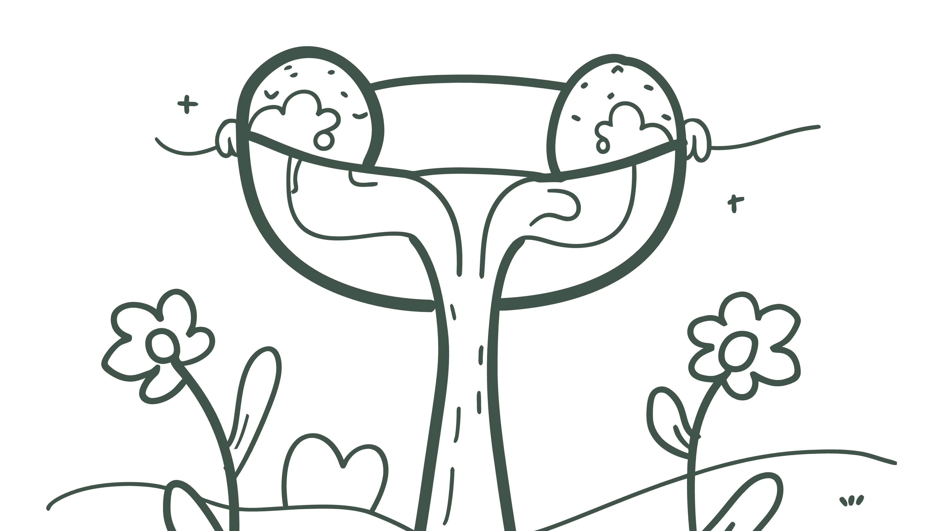
Ovulatory Phase Workshop Slides
Session 2: Peak Energy, Peak Potential
Welcome & Session Energy
OVULATORY PHASE WORKSHOP
Peak Energy, Peak Potential
Welcome to your power phase session!
Still faceless, still private
Evidence-based protocols for your peak
Harness your natural energy surge
Chat participation encouraged
Session Promise: Master the art of working WITH your peak energy while preventing and managing "ovary bloat"

Slide 2
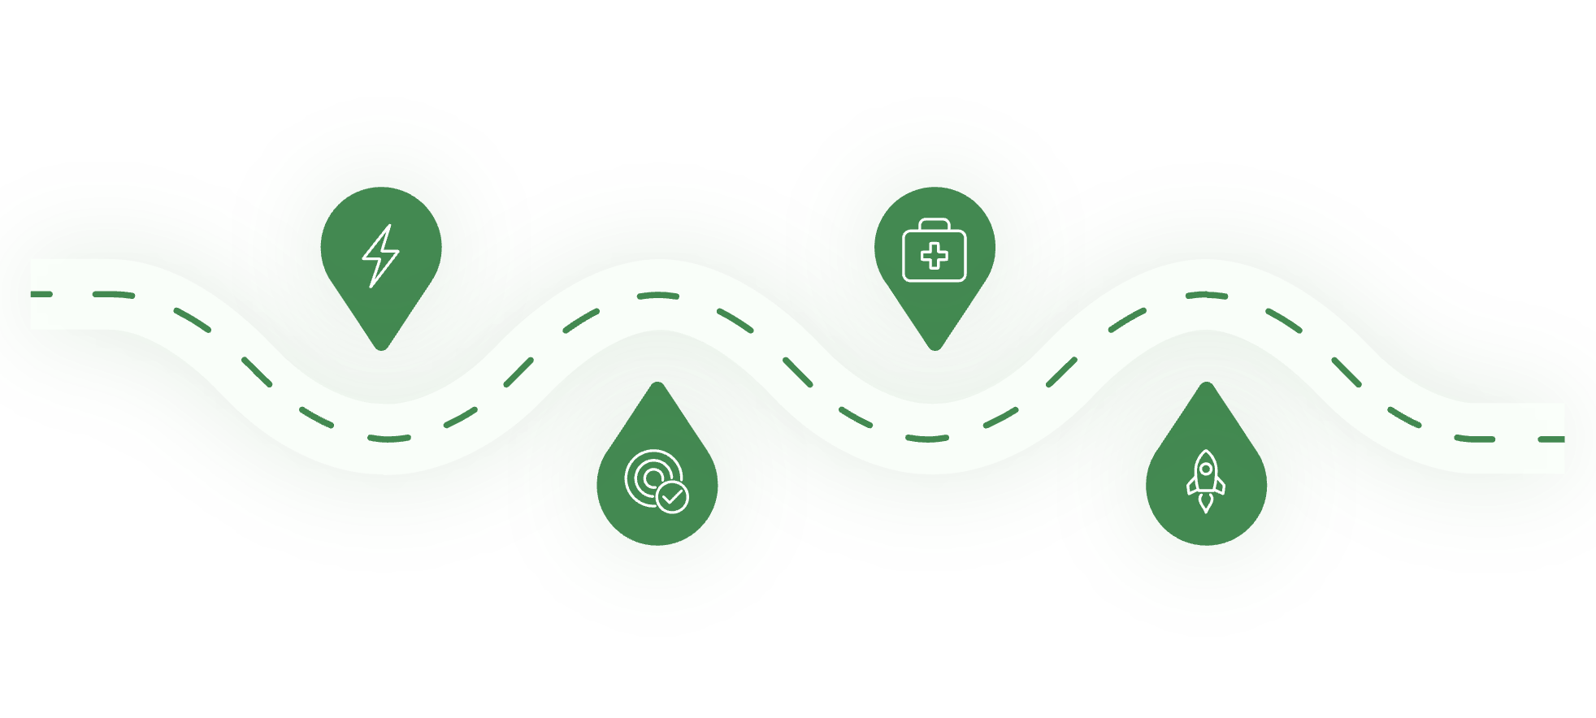




Your Ovulatory Roadmap
TODAY'S POWER-PACKED AGENDA
ENERGIZE
ACTIVATE
Peak phase physiology & power
3 high-energy protocols
OPTIMIZE
AMPLIFY
Managing mid-cycle bloating
Sustainable peak performance
Interactive Power-Ups:
Energy assessment poll
Real-time protocol practice
Peak phase planning session
Community wisdom sharing
Let's make the most of this natural high!

Slide 3
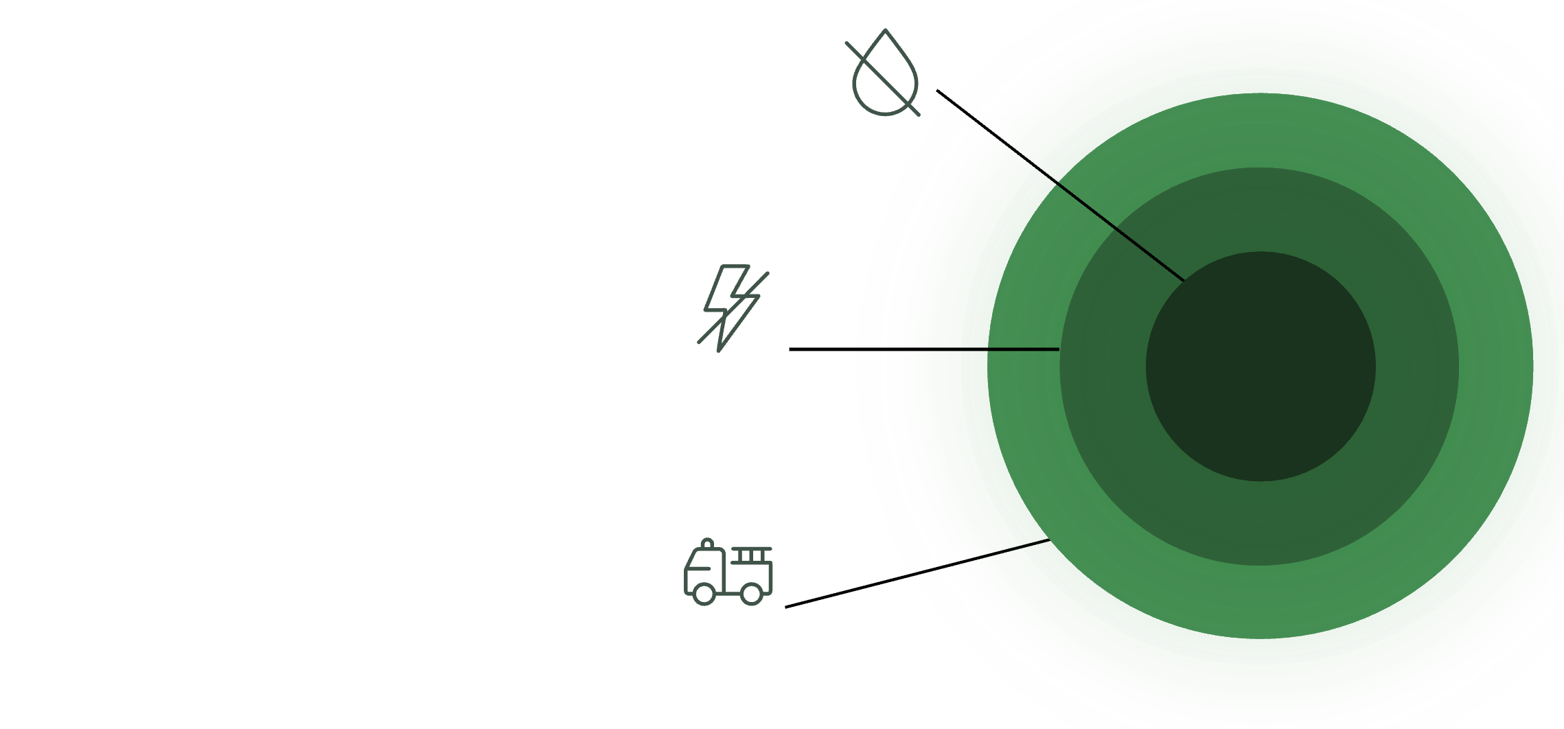



Ovulatory Physiology - Your Natural Power Surge
PEAK PHASE POWER: What's Happening
Days 8-14: Your Body's Natural High
HORMONAL SYMPHONY:
Estrogen Peak
High levels preparing ovary.
LH/FSH Surge
Triggers ovulation surge.
Testosterone Spike
Short powerful increase.

Slide 4
Ovulatory Physiology - Your Natural Power Surge
PEAK PHASE POWER: What's Happening
Days 8-14: Your Body's Natural High
PEAK PERFORMANCE BENEFITS:
Mental clarity & focus
Physical strength & coordination
Social confidence & communication
Metabolism running hot
Pain tolerance higher
THE BLOATING PARADOX: Peak energy + digestive sensitivity = need for smart strategies

Slide 5

Ovulatory Physiology - Your Natural Power Surge
PEAK PHASE POWER: What's Happening
Days 8-14: Your Body's Natural High
PEAK PERFORMANCE BENEFITS:
High Pain Tolerance
Physical Strength
Mental Clarity
Social Confidence
Fast Metabolism

Slide 6
The "Ovary Bloat" Phenomenon
UNDERSTANDING MID-CYCLE BLOATING
OVARY BLOAT BASICS:
Sharp, localized sensations around ovaries
Temporary fullness or swelling
Often one-sided (alternates monthly)
Typically lasts 24-48 hours around ovulation
WHY IT HAPPENS:
Follicle growth stretches ovary
Fluid release during ovulation
Hormone shifts affect digestion
Peak energy can mask early signals
NORMAL PATTERNS:
✓ Comes and goes with ovulation
✓ Manageable with gentle interventions
✓ Doesn't interfere with daily activities
WHEN TO INVESTIGATE:
❌ Severe pain that doubles you over
❌ Lasts more than 3-4 days
❌ Gets progressively worse each cycle

Slide 7
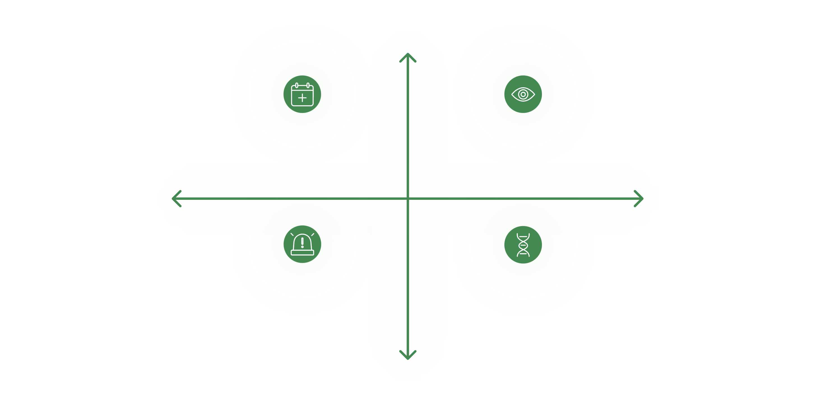




The "Ovary Bloat" Phenomenon
UNDERSTANDING MID-CYCLE BLOATING
Around Ovulation
Typical Ovulation Bloat — Mild, brief discomfort
Watchful Symptoms — One-sided fullness, manageable
Underlying Causes
Manageability
Warning Signs — Severe, worsening, >3–4 days
Causes & Context — Follicle growth, fluid, hormones
Seek Care

Slide 8

POLL - Your Peak Phase Reality
ENERGY CHECK-IN! ⚡
What's your typical ovulatory phase experience?
A) 🚀 Amazing energy, minimal digestive issues
B) ⚡ Great energy BUT noticeable mid-cycle bloat
C) 🎢 Energy high but unpredictable symptoms
D) 🤔 Energy good, never connected it to ovulation
E) 😵‍💫 Peak energy but I tend to overdo everything
F) 🆘 This is actually my most difficult phase
CHAT SHARE:
When you're feeling peak energy, what do you tend to do? (Work extra hours? Exercise more? Social activities? Creative projects?)

Slide 9

Nutrition for Peak Performance
FUEL YOUR PEAK: Ovulatory Nutrition
HIGH-ENERGY FOODS:
🥗 Cruciferous vegetables (broccoli, Brussels sprouts)
🐟 Omega-3 rich fish and seafood
🥜 Raw nuts and seeds for sustained energy
🫐 Antioxidant-rich berries and leafy greens
🥑 Healthy fats for hormone production
PEAK PHASE TIMING:
Larger breakfast - your metabolism is hot
Pre-activity fuel 30-60 minutes prior
Post-activity protein within 2 hours
Consistent meal timing prevents energy crashes
ANTI-BLOAT STRATEGIES:
✓ Digestive enzymes with larger meals
✓ Ginger tea or fresh ginger with meals
✓ Avoid rushed eating - even when energized
✓ Stay ahead of hydration needs
OVULATION SPECIAL NEEDS:
Extra B vitamins, magnesium, and electrolytes

Slide 10
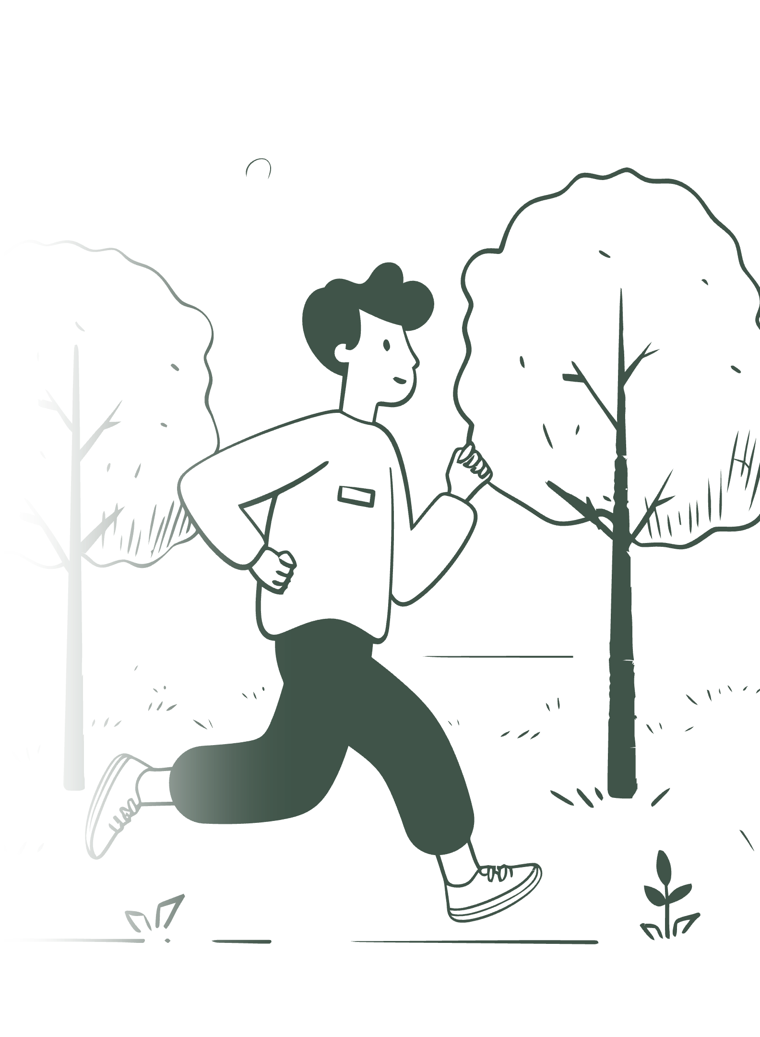
Movement That Matches Your Energy
PEAK PHASE MOVEMENT: Go for It (Smartly)
MAXIMIZE YOUR NATURAL HIGH:
💪 Strength training - you're at peak power
🏃‍♀️ High-intensity cardio - if it feels good
🧘‍♀️ Dynamic yoga or Pilates
🏊‍♀️ Swimming laps vs. gentle floating
🎾 Sports, dancing, challenging activities
OVULATION MOVEMENT RULES:
Your body can handle more - listen to that
Recovery is still important - don't skip it
Perfect time for new challenges or PRs
Social exercise often appeals more now
BLOAT-BUSTING MOVEMENT:
5-10 minutes walking after meals
Gentle twisting poses if feeling full
Core engagement (but avoid crunching if bloated)
Movement helps hormone and digestion flow
WARNING SIGNS TO BACK OFF:
Sharp ovarian pain during activity, unusual fatigue, digestive distress that worsens with movement

Slide 11
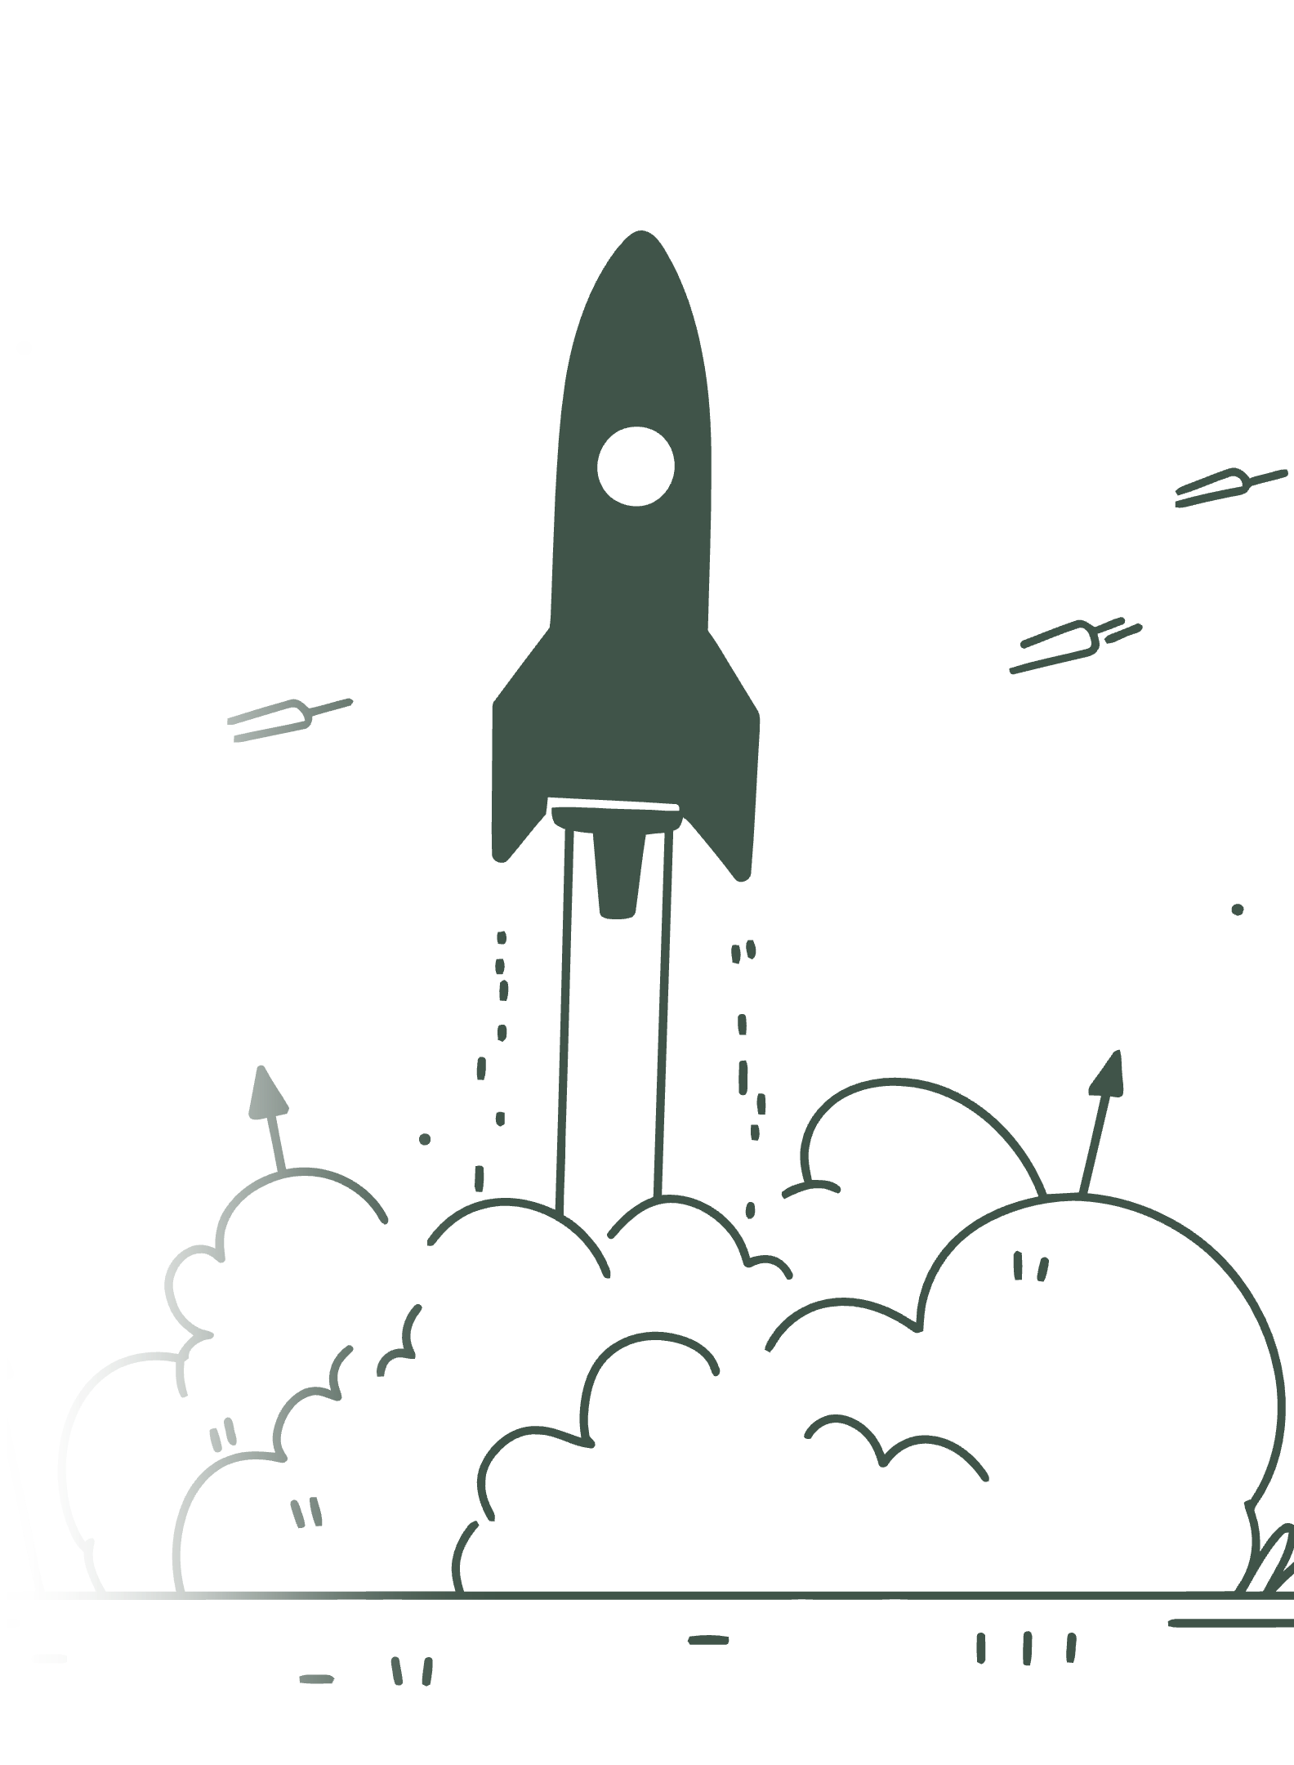
The Peak Energy Protocol
PEAK ENERGY OPTIMIZATION PROTOCOL
⏰ Total Time: 15-20 Minutes
MINUTES 1-5: POWER-UP SEQUENCE ⚡
2 minutes dynamic stretching or movement
🫖 Ginger tea or warm water with lemon
🧠 Quick energy/mood check: rate 1-10
MINUTES 6-15: CHOOSE YOUR PEAK ACTIVITY
Option A: 🏋️‍♀️ 10-minute strength circuit
Option B: 🏃‍♀️ Interval cardio burst
Option C: 💃 Dance or dynamic movement
Option D: 🧠 High-focus work/creative project
MINUTES 16-20: INTEGRATION
🫁 3 minutes breathing/mindfulness
💧 Rehydrate mindfully
📝 Set intention for peak energy use
RESULT: Channeled energy, optimized hormones, reduced likelihood of afternoon crash

Slide 12
Mid-Cycle Bloat SOS Protocol
SOS: OVARY BLOAT RELIEF
IMMEDIATE COMFORT (0-5 minutes):
🫁 Deep belly breathing: hand on chest, hand on belly
🔥 Heat pack on lower abdomen (15-20 min max)
🫖 Sip warm ginger or peppermint tea
🤸‍♀️ Child's pose or knees-to-chest position
ACTIVE RELIEF (5-15 minutes):
🚶‍♀️ Slow, gentle walk (don't power through pain)
💆‍♀️ Gentle self-massage: circular motions on belly
🌀 Gentle spinal twists while seated or lying
🛁 Warm (not hot) bath if available
HORMONE SUPPORT:
💊 Digestive enzyme if you use them
🥤 Magnesium drink or supplement
🧘‍♀️ Stress-relief - high stress makes it worse
WHEN TO REST VS. MOVE:
Sharp pain = rest and warmth Dull ache = gentle movement often helps

Slide 13
POLL - Peak Phase Optimization
OPTIMIZATION STRATEGY CHECK! 🎯
How do you want to use your peak energy wisdom?
A) 🏋️‍♀️ Focus on maximizing physical performance
B) 🧠 Channel energy into work/creative projects
C) 🌸 Balance peak energy with bloat management
D) 🤝 Use peak confidence for social/relationship goals
E) 🔄 Create sustainable peak patterns (avoid burnout)
F) 🆘 Just want to manage the symptoms better
SHARE YOUR PEAK POWER MOMENT:
Tell us about a time you felt amazing during ovulation - what were you able to accomplish? Let's celebrate these wins!

Slide 14
Your Peak Performance Plan
YOUR PEAK PHASE POWER PLAN
NEXT OVULATION CYCLE - CHOOSE 2-3:
□ Schedule important meetings/presentations during peak
□ Plan challenging workouts for peak energy days
□ Use Peak Energy Protocol 3x during ovulation week
□ Track mid-cycle symptoms with new awareness
□ Implement bloat SOS protocol at first sign of discomfort
□ Block social activities during natural confidence high

Slide 15







Your Peak Performance Plan
YOUR PEAK PHASE POWER PLAN
NEXT OVULATION CYCLE - CHOOSE 2-3:
Schedule Meetings
Plan Workouts
Peak Energy Protocol
Do challenging training on peak days
Book key meetings during peak
Use protocol 3× in ovulation week
Track Symptoms
Block Social Time
Bloat SOS
Log mid-cycle signs with awareness
Start protocol at first discomfort
Reserve solitude during confidence high

Slide 16





Your Peak Performance Plan
YOUR PEAK PHASE POWER PLAN
BALANCE YOUR APPROACH:
⚡ Honor the energy (don't waste the gift!)
🛡️ Protect against burnout (peak doesn't mean endless)
🌊 Flow with symptoms (they're temporary)
📈 Track patterns (knowledge = power)
Honor Energy
Track Patterns
Protect Burnout
Flow With Symptoms

Slide 17

Your Peak Performance Plan
YOUR PEAK PHASE POWER PLAN
SUCCESS METRICS:
✓ Feeling more intentional about peak energy use
✓ Less frustrated with mid-cycle bloating
✓ More confidence in your body's signals
✓ Better timing of important activities
Reduced Bloating
Intentional Energy
Body Confidence
Time Activities

Slide 18
Peak Energy Resources & Community
AMPLIFY YOUR PEAK POWER! ⚡
TAKE WITH YOU TODAY:
📋 Download: Ovulatory Phase Quick Reference
⚡ Download: Peak Energy Optimization Tracker
🎥 Access: Full Session Replay + Bonus Content
COMING NEXT:
🌙 Luteal Phase Workshop: "Sustainable Strength"
📅 [Date] at [Time]
🎯 Focus: Managing PMS bloat while maintaining energy
PEAK POWER COMMUNITY:
Share your wins in our private group
📧 Questions? support@fitnature.com
📱 Follow peak power tips: @FitNatureCycles
BEFORE YOU GO:
Your peak energy is not selfish - it's a resource.
Use it wisely, share it generously, and trust your body's wisdom.
Keep shining! ✨

